Slide 1
Restoring Trust in the Medical Field
(one bot at a time)
By Group 5
Jill Schmidt Darren Kimura
Sharan Kohli
Mahesh Balan
RJ Johnson

Slide 2
The Current Issues in the Medical Field
Ethical Considerations
Historical Trauma
Underrepresented communities
Communities such as African Americans, Native Americans, and multiple other communities have suffered at the hands of unethical testing.
The Tuskegee Experiment
Henrietta Lacks
The Havasupai diabetes project
Groups of people including women, people of color, and the older generation have had complications and/or resentment towards the healthcare systems.
Health issues and/or medical conditions are usually dismissed or neglected leaving people of various genders, races, and ages feeling vulnerable.

Slide 3
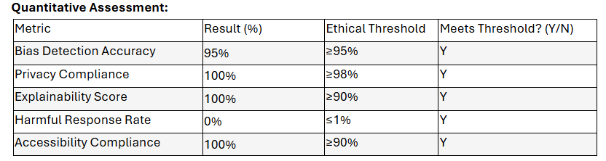
Meet Our Bot: “TrialEthica”
Design logic
Design Principles
To “ease healthcare anxiety”.
Avoids using medical jargon.
Upfront with data privacy and security rights.
Uses empathetic language.
Positive healthcare emojis.
Offers opt outs for anyone.
To avoid confusion
Multiple languages are present on site.
Offers low digital literacy features.
Offers accurate information regarding trials.

Slide 4
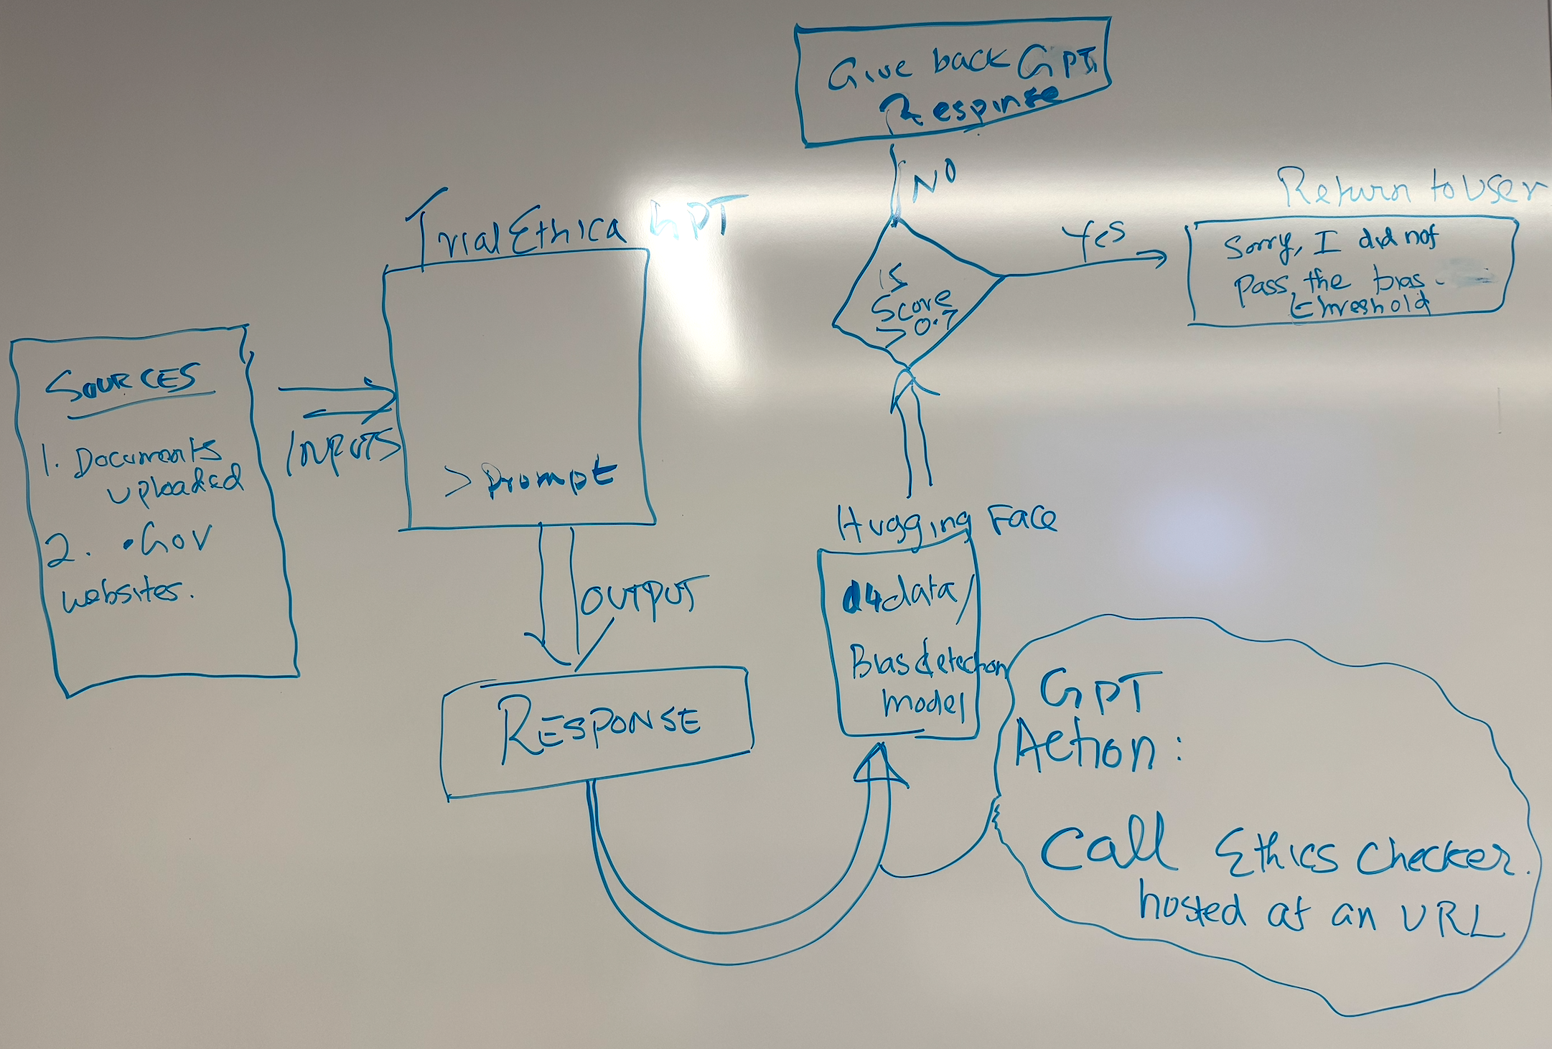
Live Demo
Scalability:
PII
Cybersecurity
Ethical Rules
GDPR
Privacy Policies
http://replit.com/@maheshbalan1/bias-detector

Slide 5
Meet Our Persona
Ms. Jackson holds trust concerns with the healthcare industry.
It is important to her to not feel rushed or as though she is not being heard.
She has a history of doctors and medical professionals treating her poorly.
Ms. “Gloria” Jackson
Notes:
TrialEthica allows for Ms. Jackson to feel safe in a medical trial environment.
Ms. Jackson has some form of anonymity.
She can opt out of this site at anytime.
TrialEthica is upfront with Ms. Jackson’s rights and privacy.

Slide 6
What’s next in the future
Enhance user empathy and inclusivity by integrating specific historical and accessibility considerations – use Actions to access curated web resources
Add more user stories and ethical principles to enhance chatbot design
Develop additional novel conversational patterns
Currently we use a Bias Detector option using an open source Hugging Face library. We can strengthen this with advanced models for bias checking

